Slide 1
Hostel Complaint Management System
TS- WEB/CC/AI TRACK CAPSTONE PROJECT
Presented By:
1. Sk Mahaboobunisa
2. Nayana Lalitha
3.Pithani Satya Sri
4.S.Prema Jyothi
Guided By: Uma Maheshwari

Slide 2
OUTLINE
Abstract
Problem Statement (Should not include solution)
Aims , Objective & Proposed System/Solution
System Design
System Development Approach(Technology Used)
Algorithm & Deployment
Conclusion
References
Future Scope

Slide 3
Abstract
Many students had troubled about raising the complaints in the hostel . There are few drawbacks in keeping and maintaining a hostel. However, the Hostel records Complaint management system is Web based software to provide college students raise the problems in hostel more efficiently. Additionally, Students raise concerns in their rooms. This particular project deals with the problems on managing a hostel and avoids the problems which occur when carried manually. It is headed by warden.
It is a software developed for managing hostel records. The software helps hostel warden in managing complaints of the hostel in an efficient manner. This project helps manage hostel rooms problems , hostel stocks and other things related to hostel problems.

Slide 4
Problem Statement
There are a lot of problems in a hostel. Especially with a manual system. Since most hostels are being run by only one hostel manager, the problems of the students in a hostel are sometimes not known by the Administrators.
And also students face so many problems regarding about hostel stocks , hostel cleaning and electricity problems. This projects helps to raise the compliant about hostel.
The problems are still pending due to the manual work but the project is digitalized so the administrators can easy to find the student problems and solve the problems very efficiently.

Slide 5
Aims and objective
The objective of the complaints management system is to make complaints easier to coordinate , monitor and identify the hostel problems.
It settling the complaints of a hostel which the students face problems in hostel.
The department can evaluate the problem of the students and handle the student problems quickly and efficiently.

Slide 6
Proposed Solution
The proposed system is having many advantages over the existing system.
The proposed system is a computerized system.
The system is to save money and time.
It require less overhead and more efficient.
The proposed system deals with the complaints process efficiently.
In proposed system the data is availability, accessibility and maintenance.

Slide 7
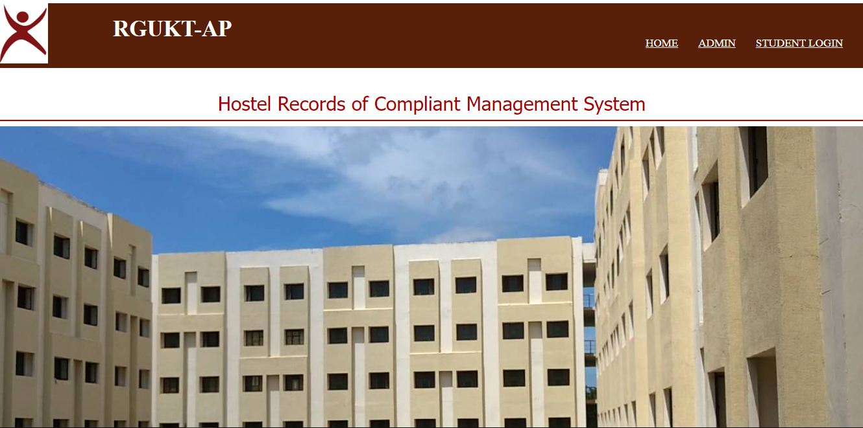
System Architecture

Slide 8
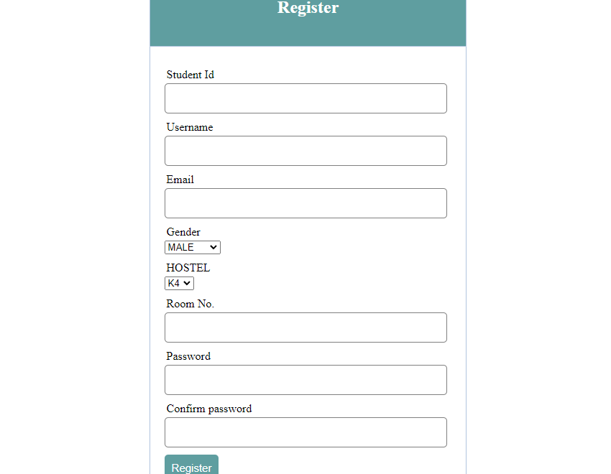
Register Page

Slide 9
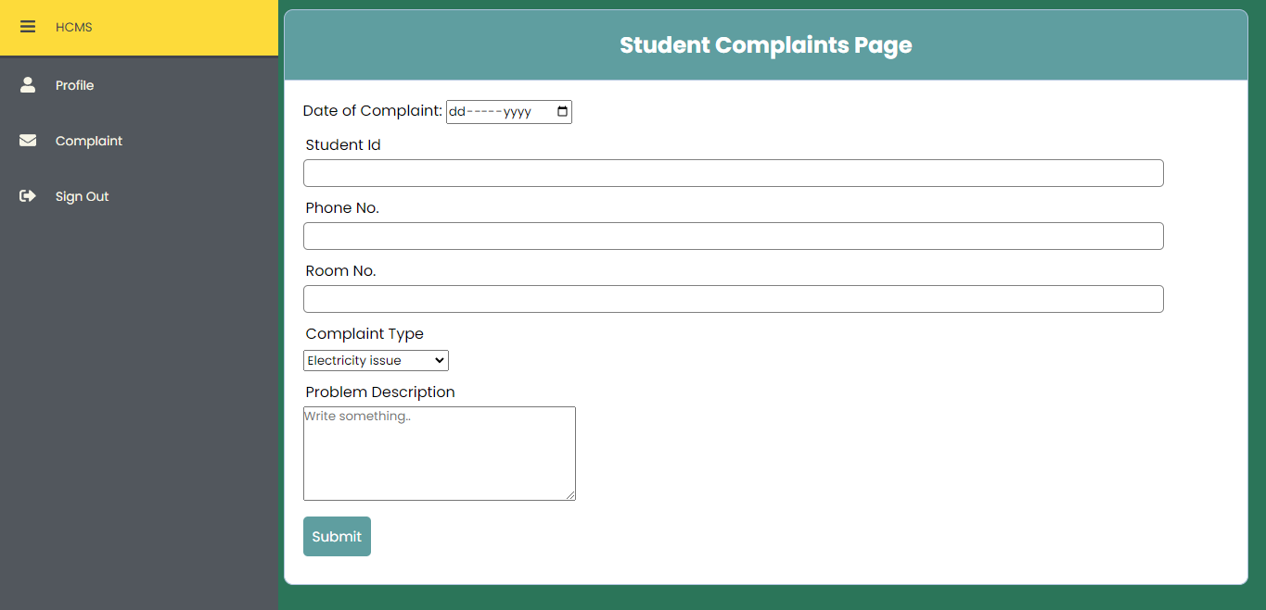
Complaint Page

Slide 10
System Deployment Approach
The Hostel complaint management system is designed using HTML, CSS, Bootstrap, Javascript , PHP and Mysql . Using Xampp we are execute our application. The admin and student login with their credentials and fill complaint box.
Admin Module
Student Module

Slide 11
Algorithm & Deployment
This system will developed based on software development life cycle with PHP and MySQL server.
PHP is good for the development and design of web based programs while MySQL is good for databases because of its security advanced features and properties.
This system use windows platform apache server, SQL for database, PHP as the language and html as user interface. Thus hostel management is technically feasible

Slide 12
Conclusion
To conclude the description of the project is to very useful for hostel complaints.
It deals with the problems on managing a hostel and avoids problems which occur when carried manually.
Identification of the drawbacks of the existing system leads to designing of computerized system.
It will be compatible to the existing system with the system which is more user friendly and works very efficiently.

Slide 13
Future Scope
To make it easier for data collection, storage and referencing reliable
The use of this project in the hostel can reduce all the problems discussed above in the current manual hostel management system.
Will make the monitoring of student moments and stock details easy.
This project enable user to store all the data of the complaints, it is very easy to fetch the data from here

Slide 14
References
https://ieeexplore.ieee.org/document/9077688
http://dspace.cusat.ac.in/xmlui/handle/123456789/1182

Slide 15
Github Link
https://github.com/NayanaLalitha67/TechSaksham

Slide 16
THANK YOU

